Slide 1

Fan-fiction
Avik Banerjee, Soumyadeep Bhattacharjee, Muhammad Hamza Butt

Slide 2

scraping
Web Scraping is a technique by which a program extracts data from websites and saves it to a file or database for further processing.

Slide 3



How it works
Collect
data from a website using a Spider
Prepare and store the data in an accessible format
Access
the data using relevant tools

Slide 4

Data extraction
A Spider is a computer program that visits URLs, parses page contents and stores the extracted data in a specified format.
Built specifically to handle the structure of a particular website.

Slide 5
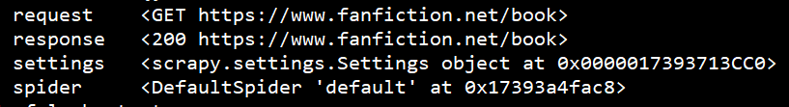
data extraction - behind the scenes
The spider sends an HTTP GET request to the host URL and receives the HTML contents as the response.
The response contains the HTML source code of the page.
Data is extracted using either XPath/CSS selectors by identifying patterns within tags.

Slide 6


Data preparation
The extracted data is packed into container objects and stored in files or databases.
Scrapy defines such container objects as Items
Items provide re-usability and ease of management over the traditional python dictionary.

Slide 7
Data access
The stored data can be accessed/analysed using tools like SQL, XQuery etc.
Can be converted to other formats like HTML for further presentation.

Slide 8
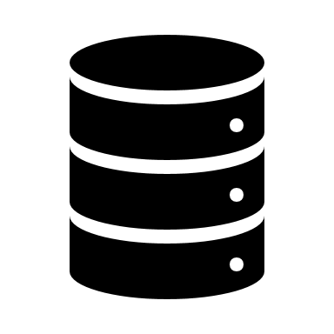

Flow of control
Scrape top 10 books from the parent URL
Store the Title and URL of each book as an XML file
Iteratively Request each URL & retrieve the Short Reviews
Store the Reviews as a JSON file
Render the content as HTML page for easier access

Slide 9
How we did it
Scraping using the python library Scrapy
Storage of extracted data in XML and JSON files
Presentation of the data as HTML pages

Slide 10
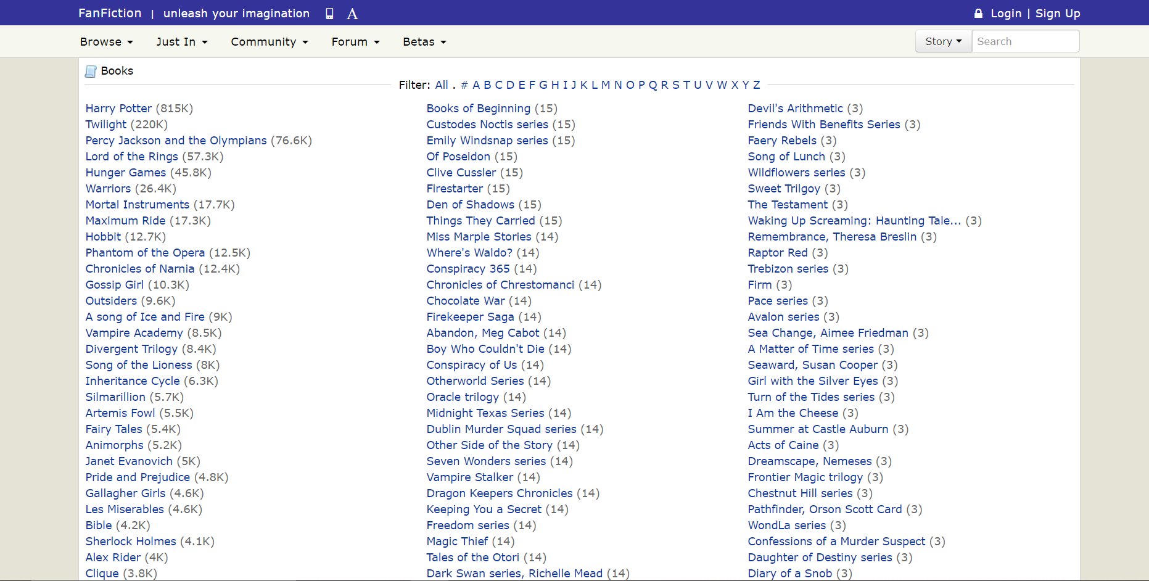
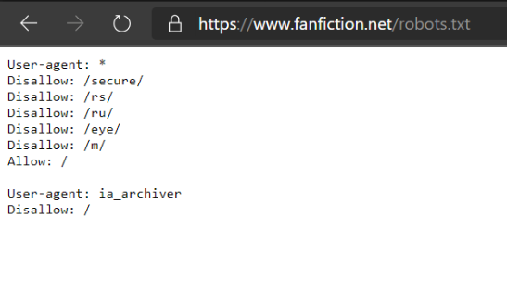
How we did it / data extraction
We selected the fan-fiction repository at www.fanfiction.net and chose to scrape the books section.

Slide 11
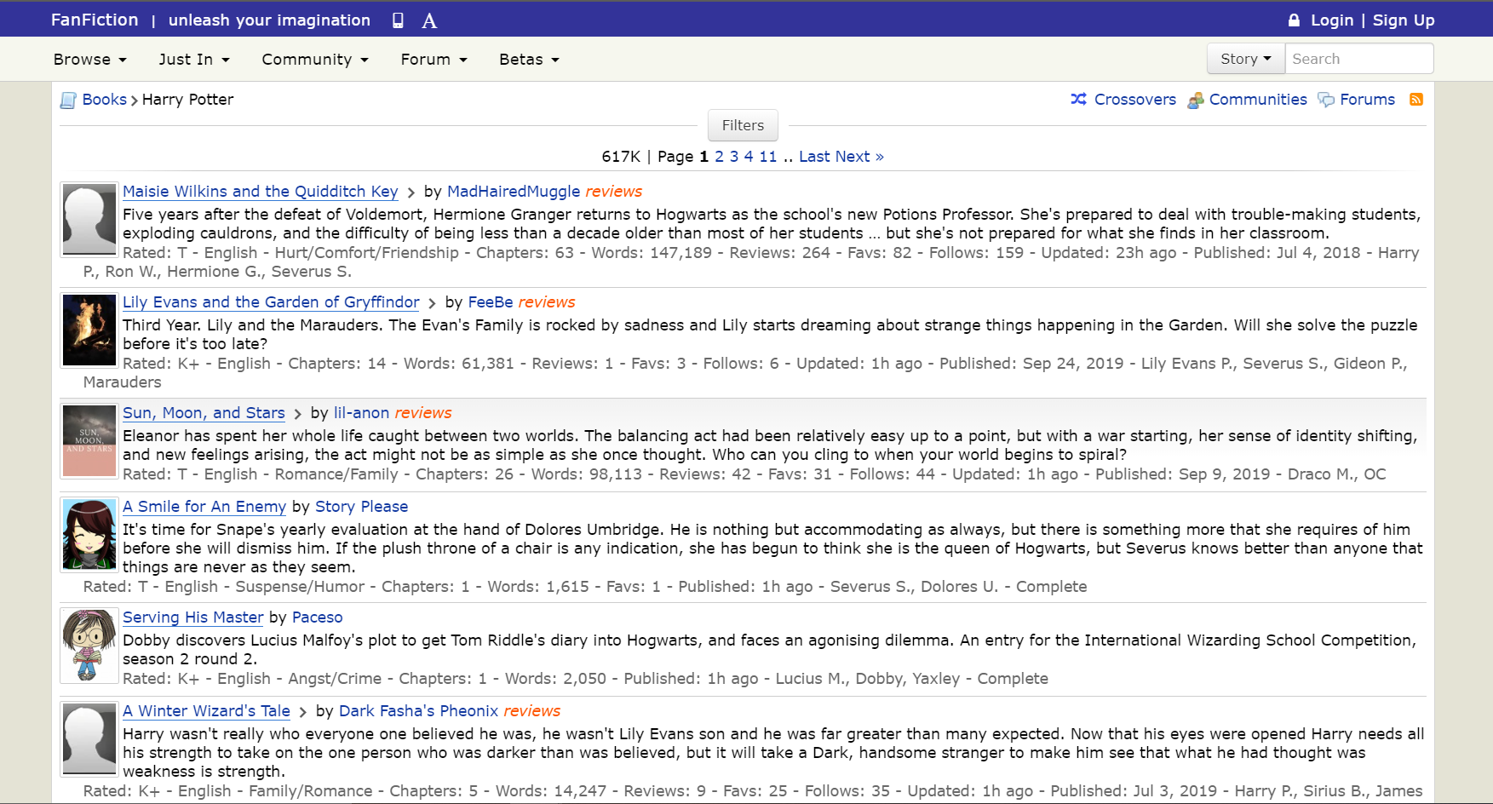
How we did it / data extraction
Our spider follows the links of the top 10 books (by number of entries) and retrieves the first page of entries.
Spider

Slide 12
How we did it / DATA Extraction
The Scrapy spider sends an HTML request to the host server and receives the HTML source of the page as response.

Slide 13
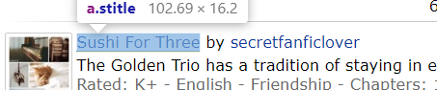
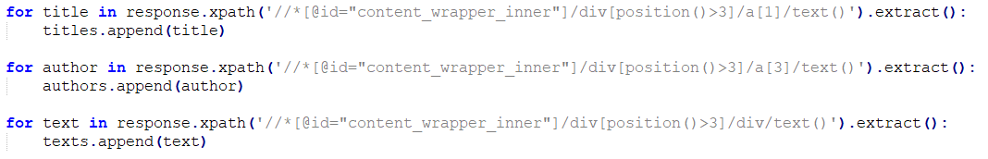
How we did it / data extraction
Relevant portions of the response are extracted using CSS and XPath selectors.

Slide 14
How we did it / data extraction
Due to incoherent structure of the page sources, the same spider could not be used to collect the expanded fan-fiction entries.
Hence two separate spiders were written: one for collecting book-names and the first page of the short entries and another for collecting both the short and long entries for one specific book.

Slide 15
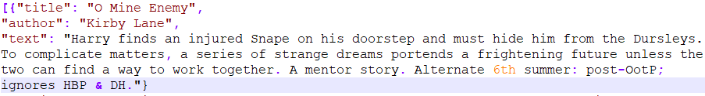
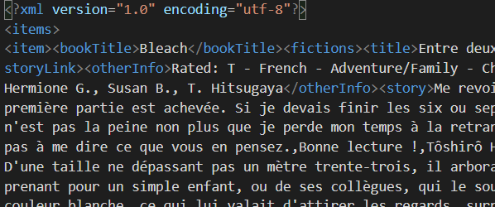
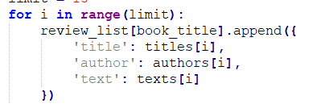
How we did it / data preparation
The extracted data were stored in container Scrapy items and finally written to XML and JSON files.

Slide 16
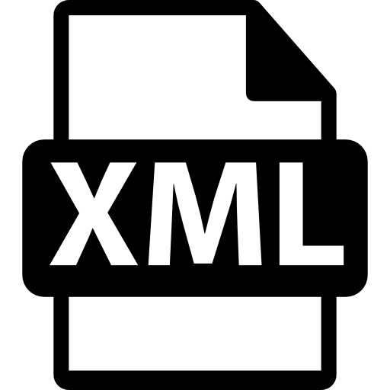





How we did it / data access
The XML and JSON files were converted to HTML pages using XSLT and the python json2html library respectively.
By W3C, CC BY 3.0, https://commons.wikimedia.org/w/index.php?curid=12736763

Slide 17

Difficulties faced
Issues with intellectual property rights of certain websites
German IPs blocked on Project Gutenberg website
Incoherent page source structures
Selecting the appropriate data to scrape

Slide 18

Future Enhancements
The data collection process could be made interactive by allowing User inputs
The entire scraping process could be combined in a single pipeline to automate the flow

Slide 19

Demo
Books1
Books2

Slide 20
Thank You

